Slide 1
Digital Cookbook & Recipe Archive Manager: Draft Persona and Moodboard
By Team Cyan
https://github.com/CarlLuidee03/SPU_CSC3220_W26_Team_Cyan

Slide 2
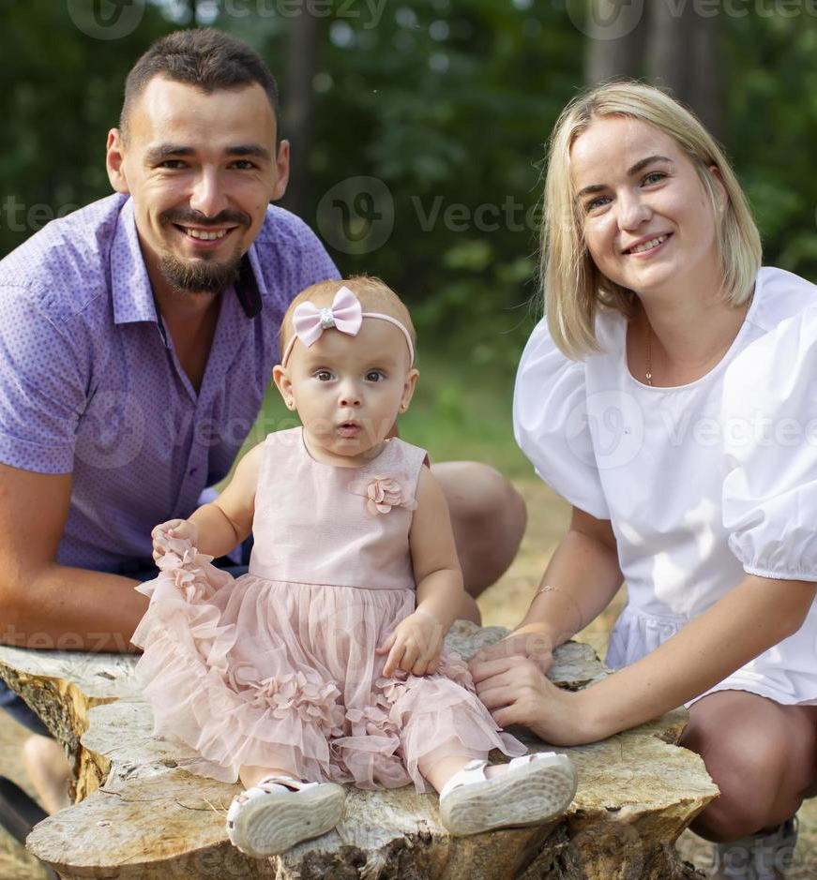
Persona
Name: Margaret Smith
Age: 37
Occupation: Accounting
Education: Bachelor's in Business
Hobbies: Cooking, Gatherings, Biking, and Photography
Marital Status: Married
Living Status: Owns a house, lives with husband and child

Slide 3
Pain and Frustration
Margaret lives with her family in a house they own. She has a successful career in accounting and has no financial worries as a result. Her hobbies primarily include cooking and hosting get-togethers with family and friends. However, her occupation and responsibilities consume most of her days, leaving her little time to pursue these activities.

Slide 4
Needs and Goals
Margaret cannot afford to waste the meager free time she is given if she wants the planned gathering to go forward, so she wants to prepare a recipe plan in advance.

Slide 5
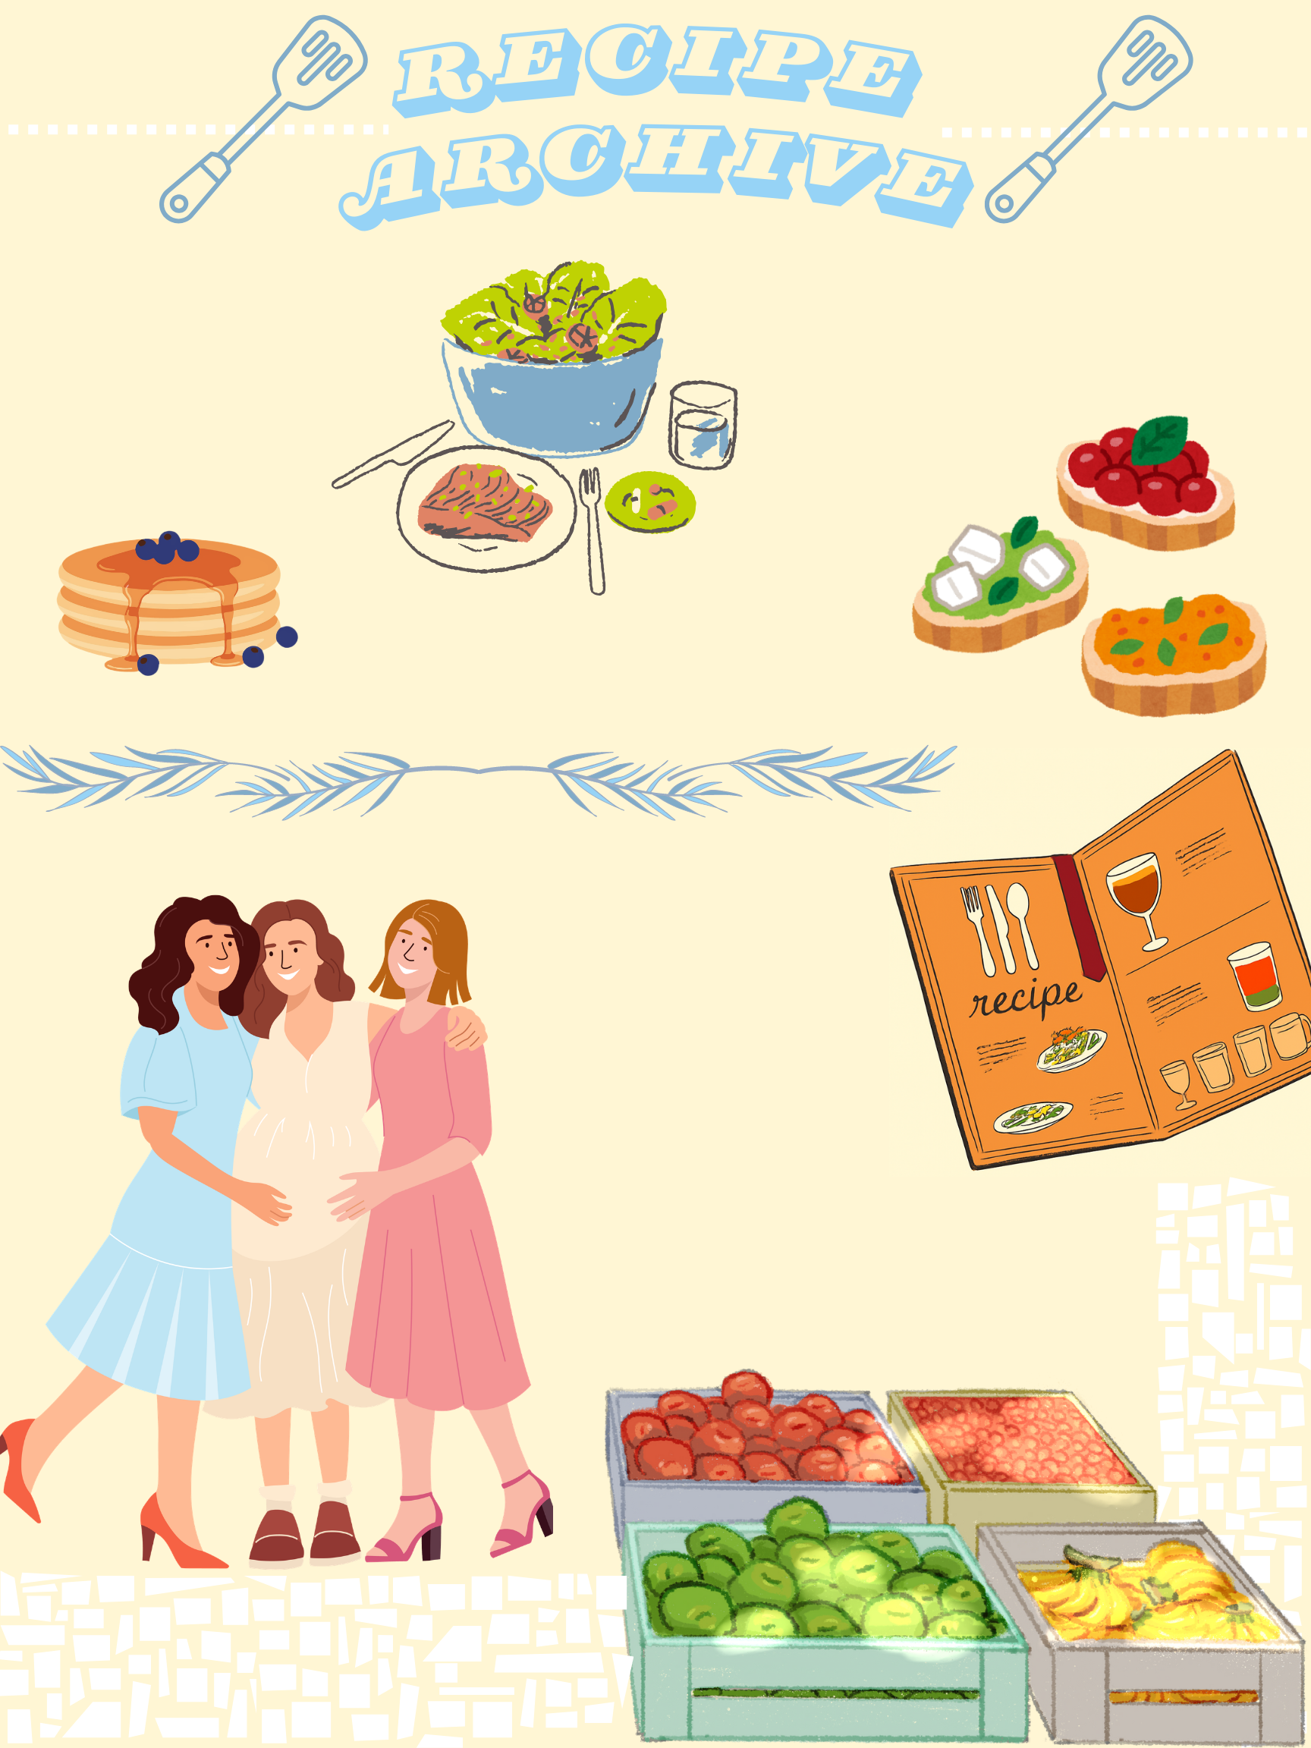
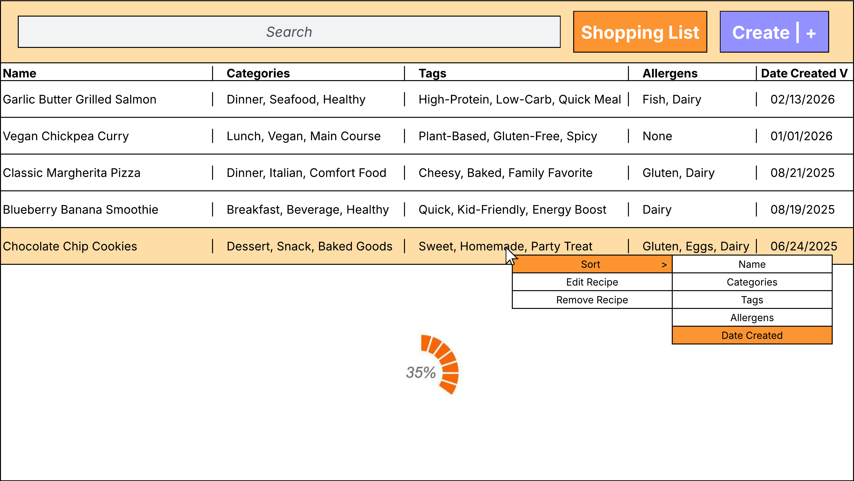
Moodboard

